Slide 1
Leadership/ communication and commitment
Basic Bus Model
Bid Packet

Slide 2
What's NEW,
Following the New format of SDE Basic bus: Set up like a Menu
Listing all required language included options: Bid what you want
Type A, C and D

Slide 3
Effective Date: July 1, 2015
Copy the model
Word document can be changed
Fill in the blanks
Don’t forget the yes and no’s
New bus inspections

Slide 4
Idaho code 67-2806
(2) When a political subdivision contemplates an expenditure to purchase or lease personal property or to procure services, other than those services excluded pursuant to section 67-2803, Idaho Code, valued in excess of fifty thousand dollars ($50,000), the procurement procedures of this subsection (2) shall apply.
(a) The purchase or lease shall be made pursuant to an open competitive sealed bid process with the procurement to be made from the qualified bidder submitting the lowest bid price complying with bidding procedures and meeting the specifications for the goods and/or services sought to be procured.
(b) The request for bids shall set a date, time and place for the opening of bids. Two (2) notices soliciting bids shall be published in the official newspaper of the political subdivision. The first notice shall be published at least two (2) weeks before the date for opening bids, with the second notice to be published in the succeeding week at least seven (7) days before the date that bids are scheduled to be opened. The notice shall succinctly describe the personal property and/or service to be procured. Copies of specifications, bid forms, bidder's instructions, contract documents, and general and special instructions shall be made available upon request by any interested bidder.

Slide 5
Idaho code 67-2806 continued
(i) If the governing board of any political subdivision chooses to award a competitively bid contract involving the procurement of personal property or services to a bidder other than the apparent low bidder, the political subdivision shall declare its reason or reasons on the record and shall communicate such reason or reasons in writing to all who have submitted a competing bid.
(j) If any participating bidder objects to such award, such bidder shall respond in writing to the notice from the political subdivision within seven (7) calendar days of the date of transmittal of the notice, setting forth in such response the express reason or reasons that the award decision of the governing board is in error. Thereafter, staying performance of any procurement until after addressing the contentions raised by the objecting bidder, the governing board shall review its decision and determine whether to affirm its prior award, modify the award, or choose to re-bid, setting forth its reason or reasons therefor. After completion of the review process, the political subdivision may proceed as it deems to be in the public interest.

Slide 6
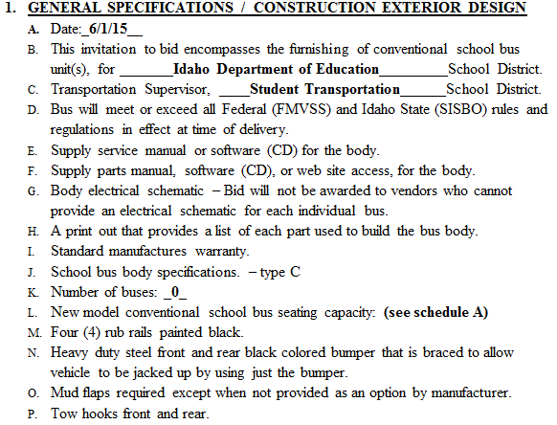
What it looks like:

