Slide 1
Perception
Dedication
Responsibility
Education
Attitude
Motivation
June 2017

Slide 2
“It’s not what you look at that matters, it’s what you see.”
 Henry David Thoreau

Slide 3
Notes:
https://www.youtube.com/watch?v=XTFsoElX-a0
Nixon’s departure from the White House – 8/9/1974.
Watergate – major political scandal following break-in at DNC HQ at Watergate and attempted cover-up by Administration.
Indictment of 69 people, with 48 being found guilty, many of whom were top Admin officials.
Dad now doing presidential advance for Ford.
First political memory.

Slide 4
Iran Hostage Crisis
Notes:
Diplomatic standoff between US and Iran. Shah, who Iran accused of committing crimes during reign, received asylum in US for cancer treatment.
Group of Iranian students took over US Embassy in Tehran.
52 American diplomats and citizens held for 444 days from 11/4/1979 – 1/20/1981.
Rescue attempt failed and resulted in death of 8 servicemen and 1 Iranian citizen and loss of 2 helicopters.
Hostages released after signing the Algiers Accord minutes after Ronald Reagan sworn into office.

Slide 5
Reagan Inauguration
Notes:
January 20, 1981
Dad aide to Neil Reagan.
Frank Sinatra behind us. All the people.
Note from military officer just before start.

Slide 6
Iran-Contra Affair Hearings
Notes:
Occurred during 2nd term of Reagan Adminsitration
Senior administration officials secretly facilitated sale of arms to Iran, which was subject of an arms embargo.
Plan was that Israel would ship weapons to Iran then US resupply Israel and receive Israeli payment. Iranian recipients promised to try to secure release. A portion of the proceeds from the weapons sales were diverted to fund the Contras in Nicaragua.
Scandal compounded with destruction or hiding of pertinent documents.
2/1987 Tower Commission Report released. 3/1987 Articles of Impeachment against President introduced. 5-8/1987 Congressional hearings.

Slide 7
“If you don’t have failures, you’re not trying hard enough.”
 Richard Branson

Slide 9
Notes:
https://www.youtube.com/watch?v=xffOCZYX6F8

Slide 10
Notes:
https://www.youtube.com/watch?v=po0jY4WvCIc

Slide 11
1.8 billion Coca-Cola drinks consumed every day.
World’s most recognized brand.
Coke v. Pepsi
1980s Coke’s market share remained the same, but Pepsi’s starting to growing.
Pepsi was gaining more new customers.
Perceiving the problem was taste, Coke started working on a new product.

Slide 12
April 23, 1985, Coke announced a product change.
A few days later production of “old coke” stopped.
Sales of New Coke Low.
Public Outrage High.
Notes:
If you have the real thing, you cannot have a new real thing.
Biggest marketing blunder of all time.

Slide 13
Notes:
https://www.youtube.com/watch?v=8vklRAGS0p4

Slide 14
July 11, 1985, Coke CEO Roberto Goizueta stated at a press conference, “We have heard you.”
When re-launched they dubbed the original “Classic Coke” for the US market.
Within months Coke had returned to its number one spot and New Coke had all but faded away.

Slide 15
Lessons Learned
Marketing is a battle of perceptions, not products.
Don’t clone your rivals.
Feel the love.
Don’t be scared to reverse course.
Do the RIGHT market research.

Slide 16
“When written in Chinese, the word ‘crisis’ is composed of two characters. One represents danger and the other represents opportunity.”
 John F. Kennedy

Slide 17
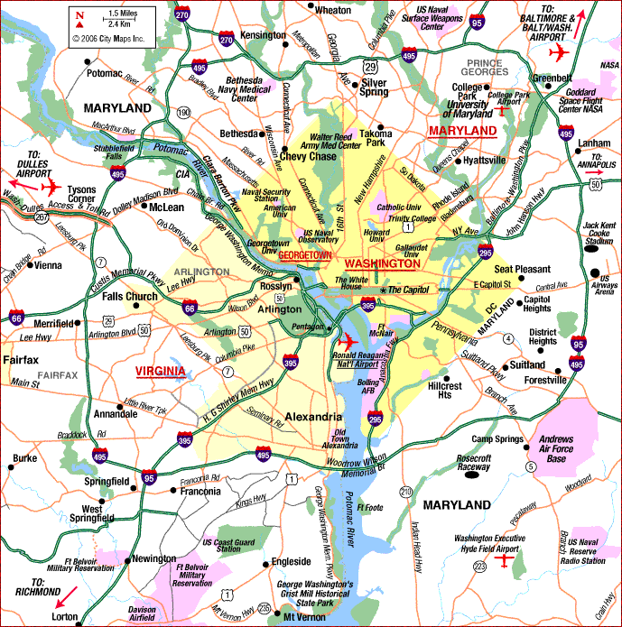

Slide 18
Sniper Shootings – Washington, DC
October 2002 – 23 days
Innocent people killed by a high-powered rifle mowing lawns, reading books on benches, pumping gas, vacuuming out their cars, running errands.
No idea who or why people were being shot.
Initially no clues. Eventually a few clues.
Montgomery County, MD asked for federal assistance because it was a serial murder case. US Department of Justice agreed. Virtually every federal, state and local agency assisted.
Worst murder spree in US history.

Slide 19
Timeline
October 2 – James Martin, 55, killed in a parking lot
October 3 – James Buchanan, 39, killed mowing lawn
October 3 – Premkumar Walekar, 54, killed pumping gas
October 3 – Sarah Ramos, 34, killed at a post office
October 3 – Lori Ann Lewis-Rivera, 25, killed vacuuming her car
October 3 – Pascal Charlot, 72, killed walking down the street
October 4 – Caroline Seawell, 43, shot in parking lot
October 7 – Iran Brown, 13, shot outside school
October 9 – Dean Harold Myers, 53, killed while pumping gas
October 11 – Kenneth Bridges, 53, killed pumping gas
October 14 – Linda Franklin, 47, killed in parking lot
October 22 – Conrad Johnson, 35, killed on steps of commuter bus
October 24 – John Muhammed and Lee Boyd Malvo arrested

Slide 20
Community Reaction
Genuine fear
Media told the public not to walk in a straight line
Media told the public not to stand near their car when pumping gas
Anyone, anywhere was a target
Dragnets were implemented immediately after shootings
Disrupted safety
Disrupted routines

Slide 21
Lessons Learned
Story went from local to national to international in 24 hours. Be ready.
Ensure everyone (inside and outside your entity) knows you are in this together.
No blueprint.
Strain on physical, financial, jurisdictional, mental and psychological resources.
Constant flow of information.
People were empowered to make decisions.
Recognition that mistakes will be made.

Slide 22
“The best revenge is
massive success.”
 Frank Sinatra
Notes:
http://abcnews.go.com/Archives/video/oct-2002-dc-sniper-murder-spree-11239504

Slide 23
Starbucks Data
1987: fewer than 100 employees.
2016: 238,000 employees.
Employee turnover rate: Less than ½ industry average.
Average sale: Under $5.
Customer Frequency: On average, 18 times per month
For years, Starbucks spent more on training employees than advertising.
Adds 2 new stores on a daily basis since 1987.
2015: Worth $5.82 billion.

Slide 24
Starbucks Vision
More than great coffee - romance of coffee.
“Affordable luxury.”
Under-promise and over-deliver.
Word of mouth is far more powerful than advertising.
Nothing can stay the same forever.
Authenticity is what makes a brand last.
Americans hungry for a community.

Slide 25
“By trying on other people’s clothes we find out
what size we are.”
 John Lennon
Notes:
http://abcnews.go.com/Archives/video/oct-2002-dc-sniper-murder-spree-11239504

Slide 26
Generations
Silent Generation/Traditionalists
Baby Boomers
Gen X
1900 - 1945
1946 and 1964
1965 and 1980
1980 and 2004
Millennials

Slide 27
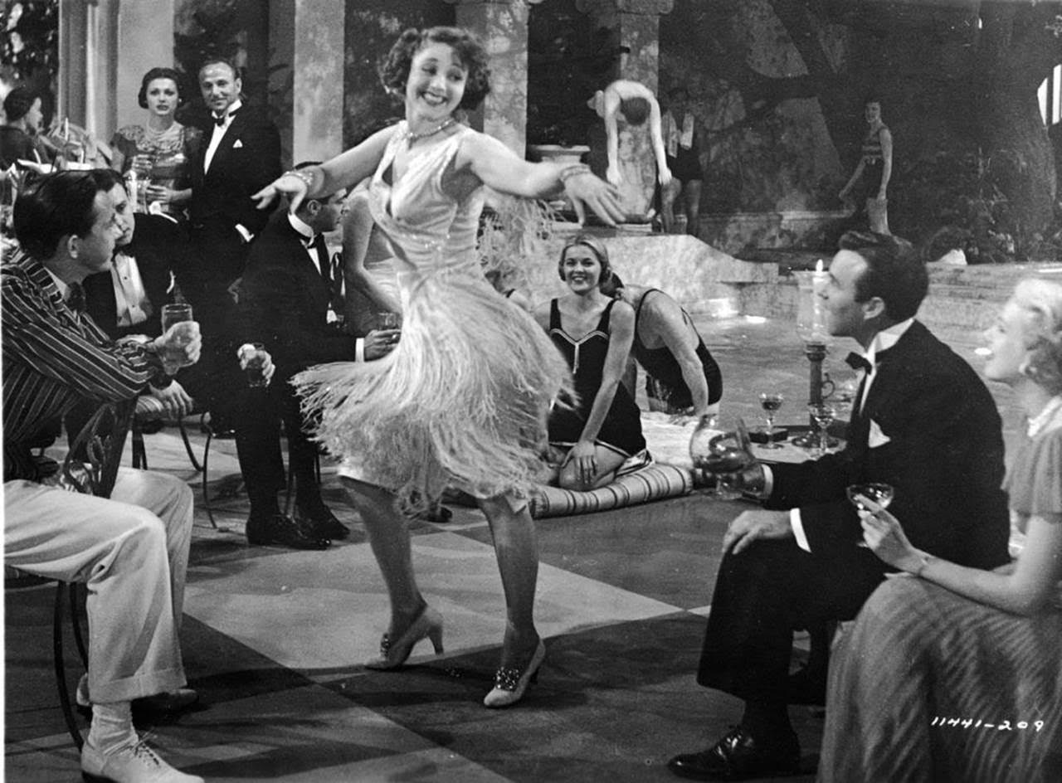
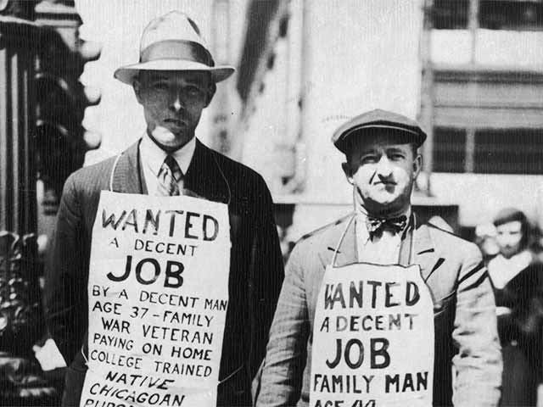
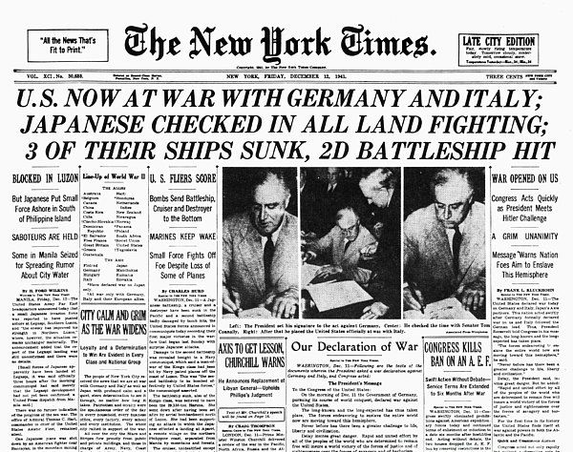
Silent Generation/Traditionalists

Slide 28
Silent Generation/Traditionalists
Influenced by: Great Depression, Roaring 20s, WW1, WW2, Korean War, GI Bill
Comparatively small because of financial insecurity of the 1930s and the war in the 1940s.
Families had fewer children.
Married and had children younger, on average, than any other generation in history.
McCarthy Era – people felt it was dangerous to speak out
Roughly 55 million adults today.

Slide 29
Silent Generation/Traditionalists
Focused on careers not activism.
Rarely talked about “changing the system,” rather “worked in the system.”
Children expected to be seen, not heard.
Believed you earn your way through hard work.
Loyal to country and employers.
Only generation never to occupy the White House.

Slide 30
Silent Generation Work Habits
Many stayed with the same employer their entire life.
Less likely to change jobs to advance career, but expected the same loyalty in return.
Good team players, respect authority.
Like to feel needed.
Less technologically adept, but great interpersonal skills.
Work ethic and reliability very important.

Slide 31
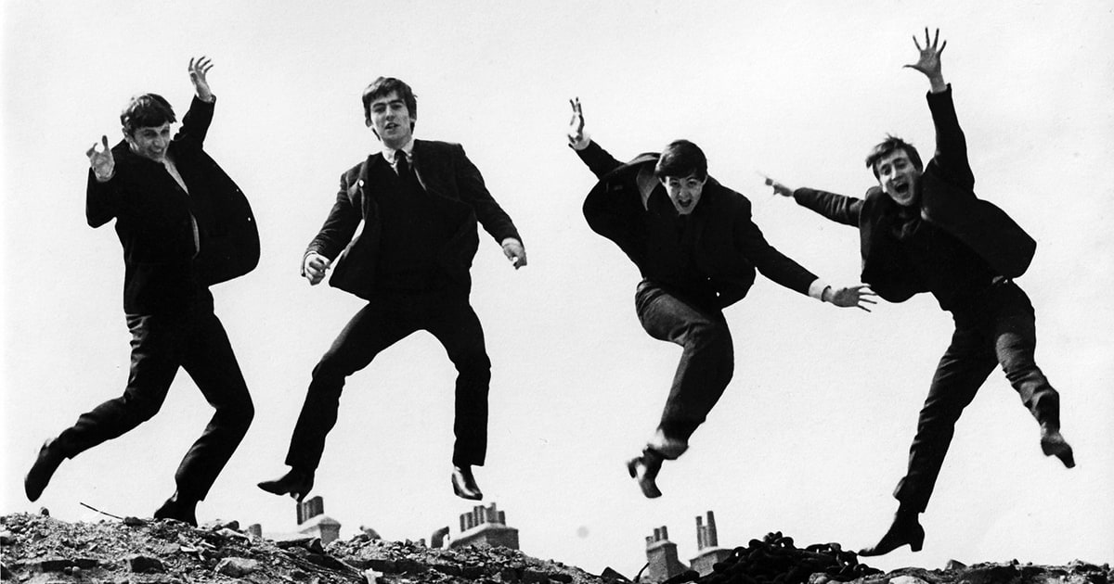
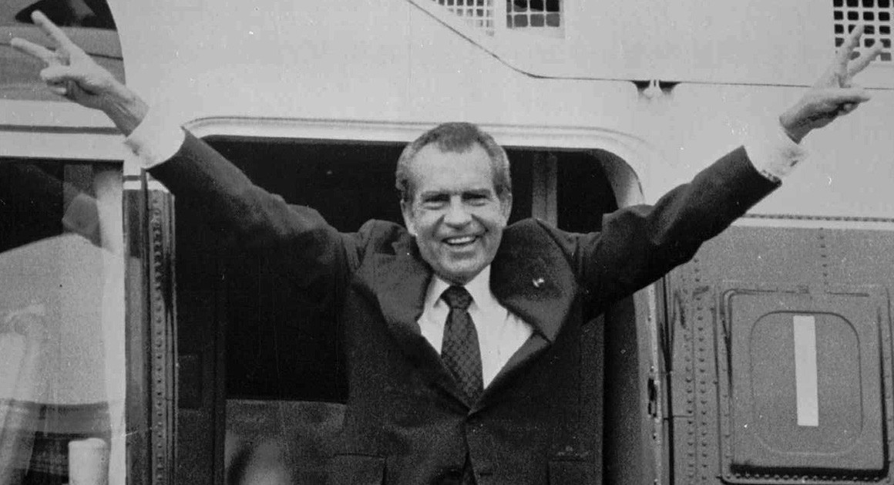
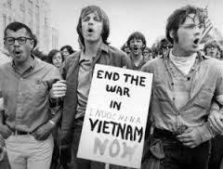
Baby Boomers

Slide 32
Baby Boomers
Increased birth rates following WW2
Influenced by the Beatles, Woodstock, TV, Vietnam, Watergate, Protests, Cold War/Russia, Space Travel, Drugs, Rock & Roll
Many grew up in time of widespread government subsidies in postwar housing, education
Active and physically fit
Tend to think of themselves as a special generation
About 76 million adults.

Slide 33
Baby Boomers
Grew up during time of dramatic social change.
Believe they can change the world.
Confident, self-reliant and independent.
Bill Clinton, George W. Bush, Donald Trump and Hillary Clinton all Baby Boomers.
Aging US workforce – by 2020 projected 25% baby boomers over age 55.

Slide 34
Baby Boomer Work Habits
Workaholic generation.
Equate work and position with self-worth.
Competitive.
Goal-oriented.
Highly-educated.
Very adaptable to diverse experiences.

Slide 35
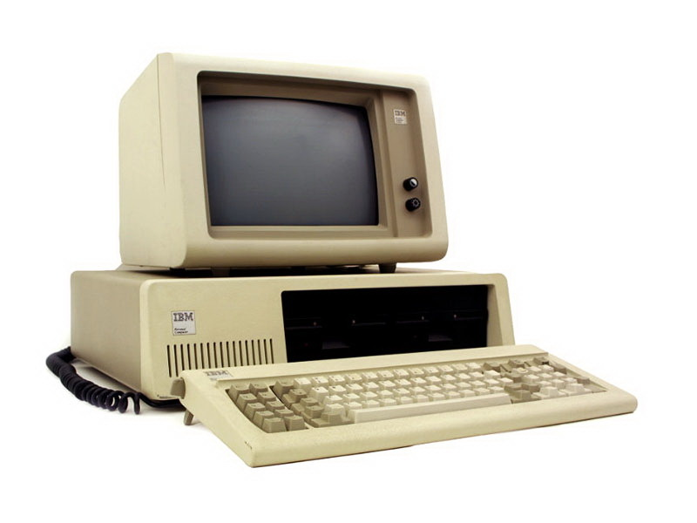
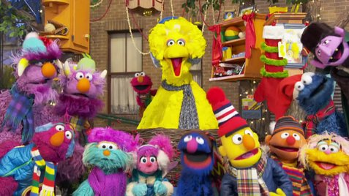
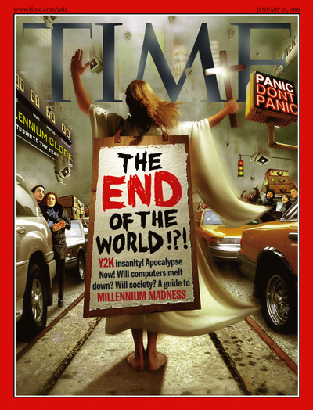
Gen X

Slide 36
Gen X
Influenced by Sesame Street, MTV, Game Boy, PC, Energy Crisis, Y2K.
More ethnically diverse and better educated than Baby Boomers.
Came of age in two income families, rising divorce rates and faltering economy.
Most children “latchkey kids” as most parents worked and home childcare options not readily available.
65.8 million in the workforce.

Slide 37
Gen X
Reflect shift from manufacturing economy to service economy.
First generation to grow up with computers.
More willing to change jobs to get ahead thanks to the layoffs of the 1980s their parents endured.
Barack Obama only Gen X to occupy the White House.

Slide 38
Gen X Work Habits
Value freedom and responsibility in the work place.
Casual distain for authority and structured work hours.
Dislike being micromanaged.
Embrace hands-off management.
Ambitious and eager to learn new skills.
Work to live rather than live to work.

Slide 39
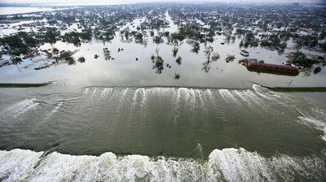
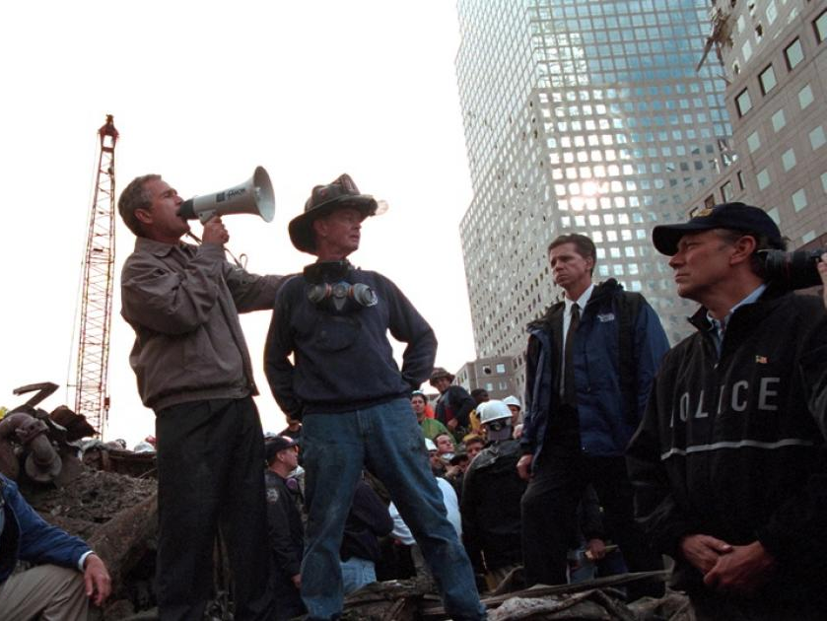
Millennials

Slide 40
Millennials
Motivated by school shootings, terrorist attacks, 9/11, AIDS, expanded technology, natural disasters, diversity
More diverse than previous generations.
Shared experiences – access over ownership.
Most health, social, economic and environmentally conscious generation.
First generation with schedules as children.
Feel obligated to make the world a better place and believe they can.

Slide 41
Millennials
Hope to be the next great generation and turn around the wrong they see today
Grew up more sheltered than any other generation as parents strived to protect them from the evils of the world.
2015 – largest share of the workforce – one quarter of the population.

Slide 42
Millennial Work Habits
Collaborative
Very educated
Pressured to succeed and advance
Starting a company, even if it fails, teaches you more than sitting in a cubicle for 10 years
Want quick results and want to move on
Impatient
Multi-taskers
Work for adventures

Slide 43
Trait | Silent | Bab y Boomer | Gen X | Millennial
Motivator | Security | Money | Time off | Time off
Value | Family/ Community | Success | Time | Individuality
Work-Life Balance | Work hard to maintain job security. | Hesitant to take time off for fear of losing place in work. | Better balance between work and family than parents. | Want balance to include work, life, community involvement and self-development.
View of Authority | Respectful | Impressed | Unimpressed | Relaxed

Slide 44
Tips for Employee Success
Traditionalist
Engage as teacher, mentor, coach – full-time or part-time.
Baby Boomer
Give flexibility, authority, respect.
Challenge to keep growing.
Gen X
Need fast feedback and credit for results.
Push them to keep learning.
Millennials
Treat them as professional colleagues and they will act accordingly.
Keep focused with speed, customization and interactivity.
Put in roles that push their limits.

Slide 45
Perception
Dedication: Commitment to your craft and the collective success of the industry.
Responsibility: Care and caution in how you proceed – your work ethic.
Education: Continual thirst for knowledge and a willingness to share that with others.
Attitude: Carry a positive outlook forward, regardless of the circumstance.
Motivation: Consider what motivates you and live in that space.

Slide 46
Failure Lessons Learned
Marketing is a battle of perceptions, not products.
Don’t clone your rivals.
Feel the love.
Don’t be scared to reverse course.
Do the RIGHT market research.

Slide 47
Crisis Lessons Learned
The story went from local, to national, to international in 24 hours. Expect it.
Ensure everyone knows you are in this together.
No blueprint.
Strain on you physical, financial, jurisdictional, mental and psychological resources. Own it.
Ensure constant flow of information.
Empower people to make decisions.
Accept that mistakes will be made.

Slide 48
Success Lessons Learned
Over promise and under deliver.
Authenticity makes a brand last.
Americans are hungry for community.
Nothing can stay the same forever.
Word of mouth is far more powerful than advertising.

Slide 49
Education, accompanied by responsibility and dedication,
mixed with the right attitude
and motivation, matter.

