Slide 1
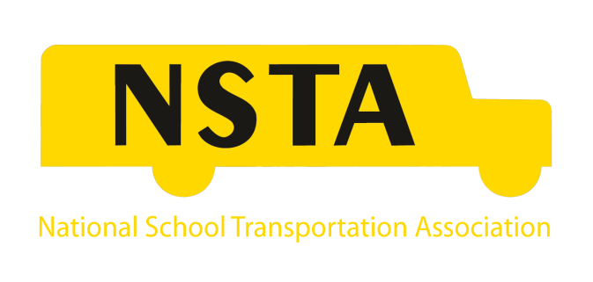
National Update
Ronna Weber
June 2017

Slide 2
Overview
Political Overview
Legislative Update
Regulatory Update
Recent Accidents & NTSB Reports
American School Bus Council
NSTA Benefits & Membership

Slide 3
Political Overview

Slide 4
Trump Cabinet Secretaries
Secretary of State, Rex Tillerson
Attorney General , Jeff Sessions
Secretary of Defense, James Mattis
Secretary of Homeland Security, John Kelly
Secretary of the Treasury, Steven Mnuchin
Secretary of Labor, R. Alexander Acosta
Secretary of Veterans Affairs, David Shulkin
Secretary of the Interior, Ryan Zinke
Secretary of Energy, Rick Perry
Secretary of Housing and Urban Development, Ben Carson
Secretary of Education, Betsy DeVos
Secretary of Health and Human Services, Tom Price
Secretary of Transportation, Elaine Chao

Slide 5
Senate Overview
U.S. Senate
52 Republicans – 48 Democrats
7 New Senators
Republican Majority Decreasesd by 4 seats

Slide 6
House of Representatives Overview
House of Representatives
241 Republicans – 194 Democrats
56 New Members
Republican Majority Decreased by 12 seats

Slide 7
Political Trifecta
Trifecta: The same political party controls the White House, the House and the Senate.
Last Republican Trifecta: The Presidency of George W. Bush, 2003-2006.
Last Democratic Trifecta: The Presidency of Barack Obama, 2009-2010.

Slide 8
Trump Administration Priorities
Regulatory Reform
Repeal and Replace ACA
Comprehensive Tax Reform
Infrastructure Investment
Immigration and Border Control

Slide 9
Regulatory Reform
Congressional Review Act: Simple majority and expedited. Limited applicability, entire rule repealed, can only be used on one rule at a time.
Executive Orders: Immediate and no Congressional action. Lasts for duration of Administration.
Appropriations Legislation: Must pass. Requires supermajority (60) votes and provision must be included.
Authorization Legislation: Permanent. Supermajority required.
Courts: Multiple entry points. Slow and uncertain result.
Rulemaking Process: No Congressional action. Slow.

Slide 10
Obamacare Executive Order
President Trump signed Executive Order January 20 directing agencies to grant relief to all affected by ACA.
Order does not detail rules affected or grant new powers.
Offers discretion to agencies administering ACA to take whatever steps necessary to reverse the policies put in place by the law and creates latitude to eliminate a variety of ACA taxes and requirements.
Real effects still being determined.
Replacement plan legislation passed the House. Awaiting action in the Senate.

Slide 11
Regulatory Freeze
White House Chief of Staff sent memo to all departments and agencies January 20 entitled “Regulatory Freeze Pending Review.”
Designed to ensure political appointees have opportunity to review any new or pending regulation.
Temporarily postponed effective date by 60 days of all regulations that had been published but were not yet effective.

Slide 12
Two-for-One Regulatory Order
President signed Executive Order January 30 requiring the elimination of two existing regulations for each new regulation proposed.
Applies to “significant” regulations – likely interpreted as imposing an economic cost of $100 million or more.
Costs of the proposed regulation must be fully offset.
Regulations overturned by courts don’t count, but those overturned under CRA generally count.

Slide 13
Legislative Update

Slide 14
NSTA’s Pending Legislative Priorities
BUSREGS-21
Obamacare: Definition of Full-Time Employee and Other Reforms
Diesel Emissions Reduction Act (DERA)
Tax Reform

Slide 15
BUSREGS-21
Buses United for Safety, Regulatory Reform and Enhanced Growth for the 21st Century (BUSREGS-21) Introduced by Congressman Scott Perry (R-PA) in April 2017.
NSTA worked with UMA and the Congressman in drafting.
Comprehensive bill designed to bring about regulatory reform for the passenger carrier industry, resulting in improved safety, expanded investments and job creation. Legislation would:
Evaluate whether existing regulations applicable to buses are achieving goals;
Modernize and streamline federal motor carrier safety and vehicle safety regulations for the industry;
Ensure regulations written to apply to both trucks and buses are fully evaluated for their appropriateness to bus operations;
Provide stronger accountability to federally-funded public transit agencies to ensure they are meeting existing requirements; and
Create an incentive program for public transit agencies partnering with the private sector.

Slide 16
“Repeal and Replace”
March 7, 2017: House Ways and Means, Energy and Commerce Committees released the initial legislative text of “Repeal and Replace.”
Bill eliminated individual mandate, employer mandate block-granting Medicaid dollars to states and shifting subsidies from income to age.
Bill passed House on May 4 by vote of 217-213.
Senate action is expected to take much longer.

Slide 17
Diesel Emission Reduction Act (DERA)
Congress provided $50 million for DERA in Fiscal Year 2016.
Under a Continuing Resolution the funding was extended to April 28, 2017.
Congress provided $60 million for DERA in Fiscal Year 2018.
$34 million available under DERA Grant Opportunity. Proposals due to EPA by July 5.

Slide 18
Tax Reform
House is planning to work from the blueprint released last year.
Senate will develop its own bill.
NSTA’s Position:
Support comprehensive tax reform to address both individual and corporate tax rates and policies;
Support fairness in tax treatment of pass through’s such as LLCs, Partnerships and S-Corporations;
Support continuance of the current exemption from the federal diesel fuel tax for school bus transportation.

Slide 19
Seat Belt Bills & Congressional Action
2016 – BELTS Act
School Bus Safety Hearing Request
2017 – Best to Use Safety Belts Act (BUS Act) of 2017

Slide 20
2016 BELTS Act
Introduced by then Congresswoman Tammy Duckworth (D-IL) and Steve Cohen (D-TN) in December 2016.
Bring Enhanced Liability in Transportation for Students Act:
Creates seat belt demonstration grant program.
Provides funding for public school districts only.
Includes State sanctions, which provide the bill’s funding, for failure to enact background check laws and illegal passing laws.
Provides grants for motion activated detection systems.

Slide 21
School Bus Safety Hearing Request
Congressmen Elijah Cummings (D-MD), Steve Cohen (D-TN) and Jimmy Duncan (R-TN) sent joint letter to House Transportation and Infrastructure Committee Chair Bill Shuster (R-PA) requesting hearing on school bus safety.
Committee is planning six hearings on surface transportation issues through June, but will not have one specific to school bus safety.

Slide 22
BUS Act
Introduced by Congressman Charlie Crist (D-FL) in April 2017.
Mandates lap-shoulder belts on all new school buses.
Effective 90 days after enactment.
Creates a new DOT safety upgrade grant program to state education agencies and school districts to fund retrofits and make other safety improvements to the bus.
Private sector not eligible.
$3 billion in funding authorized.
House Transportation and Infrastructure Committee not supportive of moving the legislation.

Slide 23
NSTA Position on Seat Belt Legislation
The decision to equip school buses with seat belts should be a state and/or local decision.
Any federal funding should be available to all school transportation providers equally.
NSTA opposes:
Retrofitting.
Federal sanctions that withhold state funding allocations to enact certain laws.
Stop arm violation funding from being used to equip school buses with seat belts.
NSTA encourages:
The study of effective countermeasures and an educational effort to address illegal passing.
A study on the effectiveness of motion-activated detection systems.

Slide 24
Regulatory Update

Slide 25
FMCSA – Entry Level Driver Training FINAL RULE
2007 Proposal:
120 Hours Class A; 90 Hours Class B or C
Motor carriers could develop their own training programs, but all programs would have to be accredited as independent training institutions.
Business would have to be operational for 1-2 years before applying.
Final Rule issued 12/8/16, Effective date delayed by Administration to 6/5/17.
Compliance date: 2/7/2020.

Slide 26
ELDT (Continued)
NSTA served on Negotiated Rulemaking Committee.
Applies to all individuals applying for a CDL, CDL upgrade or CDL endorsement to operate in interstate and intrastate commerce after 2/6/2020.
No minimum hours requirement for theory or behind-the-wheel.
Everything done electronically.
NO paper copies.
Companies need to register to provide training.
NSTA Resource document provides more information.

Slide 27
FMCSA-Drug & Alcohol Clearinghouse – FINAL RULE
FMCSA issued Final Rule 12/5/16. Effective date: 1/4/17. Compliance date: 1/1/2020.
Establishes Drug & Alcohol Clearinghouse for commercial truck and bus drivers to serve as repository of violations of FMCSA’s drug & alcohol testing program by CDL holders.
Carriers will be required to query the system for current and prospective employees.
Drivers can review their information at no cost.
Drivers must grant employers permission to access records.

Slide 28
Safety Fitness Determination
FMCSA issued Notice of Proposed Rulemaking 1/21/2016.
Proposed revised methodology for issuance of a safety fitness determination (SFD). New rating: “Unfit” or no rating.
FMCSA had announced a Supplemental Notice of Proposed Rulemaking (SNPRM) forthcoming.
3/23/2017 Withdrew NPRM and cancelled SNPRM saying FMCSA must receive and review the National Academy of Science study (required by FAST Act) and assess corrective actions and complete additional analysis.

Slide 29
Financial Responsibility
Passenger carriers required to carry minimum of $5 million per vehicle.
FMCSA considering raising minimum to at least $20 million and indexed for inflation.
FMCSA issued Advance Notice of Proposed Rulemaking (ANRPM) 11/28/2014.
Sought public comment on whether to exercise discretion to increase minimum levels of financial responsibility, and if so, to what levels.
FMCSA received 2, 181 comments.
Citing lack of sufficient data, FMCSA withdrew the proposal on 6/5/2017.

Slide 30
OSHA Final Rule on Records of Recordable Injury & Illness
OSHA published Final Rule on an employers continuing obligation to make and maintain an accurate record of each recordable injury and illness 12/19/16.
Final Rule was to become effective 1/18/17.
Congress used Congressional Review Act to turn back the Final Rule.
Restores requirement that records must only be kept 6 months.

Slide 31
NHTSA- Education of Proper Use of Seat Belts
NHTSA , through a third-party vendor, ToXcel, contacted NSTA for assistance identifying school districts who have or who are planning to implement seat belts on school buses.
NSTA informed members of the survey on 5/22/17.
NSTA informed members participation is voluntary; NSTA will not receive information collected; and the only decision-based questions asked imply your decision is budgetary or “other.”
NHTSA using survey information to group respondents for interviewing in an attempt to understand state and local decision making and funding mechanisms used.
NHTSA also plans to study bus driver distractions related to belt use via the survey information provided.

Slide 32
NHTSA – Autonomous Vehicles
NHTSA/DOT guidance encourages current leaders to drive the policy with regulations to follow.
Corporations and States ahead of Federal Government, but Federal government quickly engaging.
Current Corporate Players:
Corporations (Google, Apple, Microsoft, Bosch)
Car Manufacturers and Suppliers
Uber, Lyft
Current government players:
FMCSA, NHTSA, FTA, FHWA, NTSB, DHS, DOD

Slide 33
NHTSA – Autonomous Vehicles
DOT created Autonomous Vehicle Advisory Committee in January 2017 to provide information, advice and recommendations on cross-modal matters related to the deployment of autonomous vehicles.
Committee expected to focus on safety, mobility, environmental sustainability, state of good repair, human impact, data use and cybersecurity.
NSTA continues to engage on issue to ensure school buses and their safety concerns are not overlooked or misunderstood.

Slide 34
Volkswagen Settlement
Volkswagen (VW) recently announced a partial settlement which will create 2 funds for diesel vehicle replacement and repowering and electric and fuel cell vehicle deployment.
The states will manage Mitigation Trust Fund (MTF), while VW, with oversight from EPA and CARB will manage the ZEV Fund.
Trustee for MTF recently named.
ID MTF Allocation: $17,349,037.39.
NSTA resource document provides greater information on how you can engage.

Slide 35
GAO Report on School Bus Safety
Issued January 2017 following FAST Act requirement.
Examined:
Fatal crashes involving school buses 2000-2014; and
Federal and state school bus related laws and regulations.
Crash Findings:
0.3% of fatal motor vehicle crashes involve school buses annually.
72% of fatal school bus crashes occurred during home-to-school and school-to-home travel times.

Slide 36
GAO Report - Continued
Laws and Regulations Findings:
Federal regulations for school bus vehicle standards and driver licensing apply to both school districts and contractors.
New school buses meet more FMVSSs than any other type of new motor vehicle.
Federal safety regulations for commercial motor vehicle operations apply in certain cases.
All 50 states require some type of school bus inspection.
44 states require refresher training for drivers.
Less than 25% of states set maximum bus age and seat capacity requirements.
School bus transportation does not differ based on type of operator.

Slide 37
Louisiana School Transportation Task Force
5/2016 - State of Louisiana passed resolution forming a Task Force on Student Transportation and School Bus Passenger Safety to conduct a full review of student transportation and school bus passenger safety in light of the recent NHTSA recommendation on seat belts on school buses.
NSTA named to the Task Force.

Slide 38
Louisiana School Transportation Task Force - Continued
Committee report was finalized and submitted to the Senate and House committees on education January 31, 2017.
Report supports compartmentalization as the only form of occupant protection unless funding is provided for seat belts and school bus attendants.
Report raises concern of emergency evacuations of belted passengers in thermal and water events.

Slide 39
NTSB School Bus Accident Investigations & Recommendations
Anaheim, California
Baltimore, Maryland
Chattanooga, Tennessee

Slide 40
Anaheim, CA – 4/24/14
Posted speed: 35mph. Bus speed: 43 mph.
Accident Sequence:
Bus traveling down hill and traveled out of lane to the right.
Left roadway and overrode right curb.
Struck and dislodged concrete light post.
Continued up embankment.
Struck and uprooted tree.
Left side of bus scraped large tree from front to rear axle.
Bus rested on 30 degree embankment, leaning onto tree.

Slide 41
Anaheim, CA

Slide 42
Anaheim, CA

Slide 43
Anaheim, CA
Accident involved school bus with driver and 11 students. Driver and 4 students seriously injured.
School bus had lap/shoulder belts and a continuous video recording system.
Driver had medical issue and was unresponsive for the duration of the crash event and most of the recorded post-crash events.
Driver did not report his medical issues to the school district or a Certified Medical Examiner prior to crash.
Accident simulations showed that injuries would have been greater if the bus were not equipped with seat belts – especially for the 2 occupants in row 8.

Slide 44
Anaheim, CA – NTSB Recommendations
H-16-7: Inform school bus drivers of the impact their health may have on the safe transportation of school children, of their responsibly to accurately and completely report their health history and medications, and of the legal consequences of dishonesty on the medical examination report.
H-13-36: Provide your members with educational materials on lap and shoulder belts providing the highest level of protection for school bus passengers, and advise states or school districts to consider this added safety benefit when purchasing seat belt-equipped school buses.

Slide 45
Baltimore, MD – 11/1/16
Posted speed: 35 mph. Bus speed: 57 mph.
Accident sequence:
School bus traveled through intersection and struck rear of a 2012 Ford Mustang.
Mustang struck the south curb of the roadway and collided with a brick wall and a metal fence before coming to rest in the eastbound lane.
School bus continued, crossed the center turn lane, entered westbound lane and collided with a 2005 transit bus.

Slide 46
Baltimore, MD

Slide 47
Baltimore, MD – Preliminary Report
School bus occupied by driver and aide only. No students.
Transit bus occupied by driver and 13 passengers.
Both bus drivers and 4 transit bus passengers were killed.
7 transit bus passengers seriously hurt.
Other driver (Mustang), school bus aide and other transit bus passengers sustained minor injuries.
School bus driver had history of hypertension, diabetes and seizures. In past 5 years driver had had at least 12 crashes or incidents while operating a school bus or personal vehicle.
School bus driver’s medical certificate was not on file with MVA at the time of the accident. MVA had notified driver 2 months prior that he was no longer authorized to operate a CMV.
Accident remains under investigation.

Slide 48
Chattanooga, TN – 11/21/16
Posted speed: 25mph/30 mph.
Accident Sequence:
While traveling southbound, the bus departed the roadway to the left and collided with a utility pole.
Following the collision, the bus overturned onto its right side and then collided with a tree.
The collision with the tree caused the roof of the bus to collapse inward.

Slide 49
Chattanooga, TN – 11/21/16

Slide 50
Chattanooga, TN – Preliminary Report
School bus occupied by a driver and 37 elementary students.
Six children were killed and 31 students were injured. The driver received minor injuries.
The driver, an employee of Durham School Services, was licensed and had a current medical certificate.
Driver’s preliminary toxicology test was negative for alcohol and illegal drugs.
Since August 2016, the driver had one reportable and one non-reportable accident, both while operating school buses.
School bus equipped with multiple systems capable of recording and transmitting event-related data.
All aspects of the crash remain under NTSB investigation.

Slide 51
American School Bus Council

Slide 52
2011 NHTSA Campaign
In 2011 ASBC served as an advisor to NHTSA to create messaging that promoted the benefits of school bus ridership.
The campaign included the development of:
Branding materials (logo, slogan) through focus group testing
Infographics
Animation
Web and social media messages

Slide 53
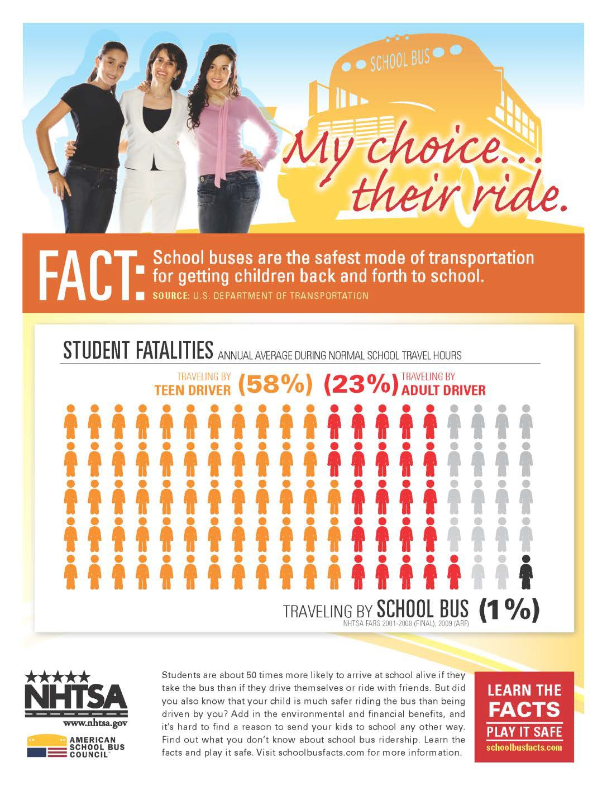
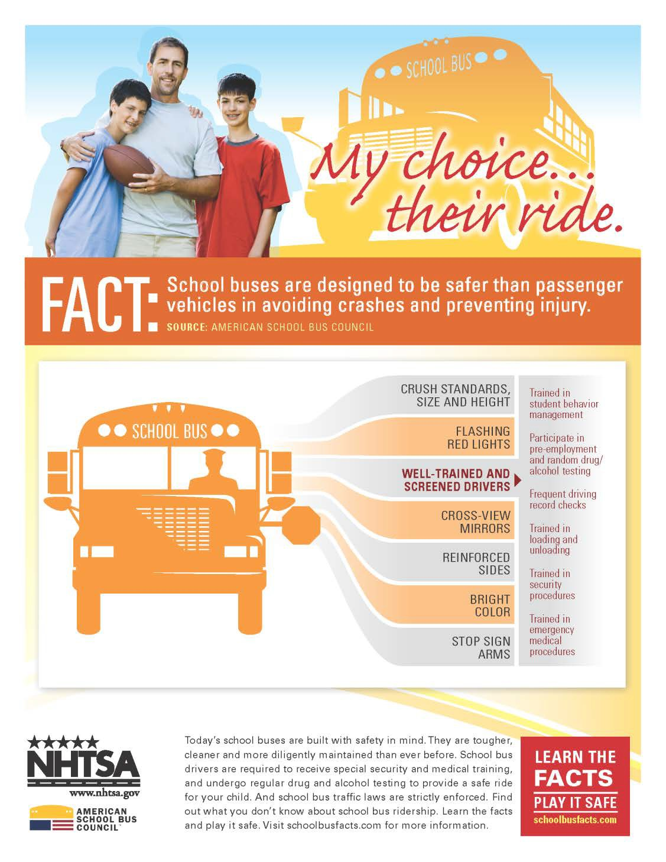
2011 Campaign Materials
The “Learn The Facts” campaign launched through the website schoolbusfacts.com in 2011.
Materials targeted parents, school board administrators, and school communities at large.
Messaging evolved towards statement of facts and included the use of informational graphics.
Notes:
Here are the images of the first generation of campaign materials for “Learn the Facts”
The campaign launched through an ASBC sponsored website schoolbusfacts.com in 2011.

Slide 54
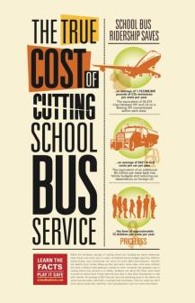
2011 Campaign Materials
Animations were created based on the 5 infographics noted here.
An average of 10,000 unique visits per year to schoolbusfacts.com
In the last 5 years ASBC distributed over 5,000 posters within the transportation industry.
Notes:
(*RONNA NOTE: There is a hyperlink to one of the animations in this slide. If you have access to internet, you can click it and it will play. This will be helpful to show to audience who may not understand animation video and can see how we used the content of the posters/fliers to create the video. )
The campaign was very successful but it has been over 5 years since its release. As the safety information evolves, so must our messaging. [NEXT PAGE]

Slide 55
2016-2017 Campaign Objectives
Campaign Objectives:
Let communities know about the benefits of school bus ridership.
Inform communities and caregivers about safety in and around the school bus.
Let others know about the ways they can support the school bus in their community.
Notes:
NHTSA and ASBC partnered through a cooperative agreement this summer to update the original materials and expand the list of resources and messaging.
Materials have been developed to support one or more of these three objectives:
Benefits of school bus ridership
Safety Practices
Communities supporting school bus

Slide 56
Campaign Target Audience
Industry Stakeholders (school bus industry professionals and associations, state and school officials in charge of coordinating transportation of students, and private transportation providers)
Communities (neighborhoods, districts, educators, commuters, environmental groups and community leaders)
Parents and Caregivers
Motorists
Notes:
We will encourage parents, school administrators, communities, industry stakeholders, media, and legislators to use it to spread the word about school bus ridership.
This years campaign has expanded its audience by adding motorist. Specific materials for motorists have been developed to address their contribution to the safety around school bus. This also includes the development of a logo called “Brake for the bus”

Slide 57
2016-2017 Campaign Products
Posters
Fliers
Tip sheets
Tri-fold brochures
Facebook and social media graphics
Animations
Drop-in articles
Supporting graphics
Notes:
Over 45 products will be produced and within one of these categories:
Posters are good for posting in public areas such as community centers, schools, libraries, and transportation centers. Because they are larger than fliers, they can be seen from a greater distance.
• Fliers are ideal for distribution to a larger audience. They are conveniently sized to fit in folders and print inexpensively on desktop printers. Electronic fliers can be posted online, and emailed. All fliers provided are one-sided to preview well within the body of most desktop email software.
• Tip sheets are a form of flier that provides instructional information on a particular topic. These can be distributed directly to intended audiences or used as resource material to instruct through other methods.
• Tri-fold brochures are ideal for mailing and other proactive outreach efforts. They fit a standard envelope and their narrow format make them ideal as portable handouts at events.
• Facebook and other social media graphics can help spread the word in a viral way. Images garner more exposure than copy through social media, and are more likely to be shared or liked.
• Animations also have viral potential. 30 second animations are timed for social media exposure, while a 2-minute instructional animation can communicate safety practices in a way that captures attention and details information more effectively and efficiently than written or verbal instructions.
• Drop-in articles are written for journalists of all types to use to help spread the word. The information can be used verbatim or personalized by the author.
• Supporting graphics are key pieces of information that allows marketers to use elements from the products in other ways.

Slide 58
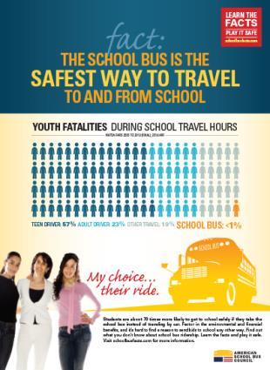
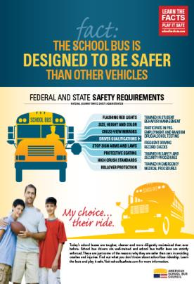
Five Revised IGs
Notes:
Although most of these products are being tweaked in the next couple of weeks, we wanted to share with you what they currently look like as the edits are minor.
These are the first 3 sets of infographic fliers that we updated with our research and NHTSA data.
From a branding perspective we incorporate new color scheme but kept the typography and images to build on brand familiarity.
Community Benefits Flier: on the far left focuses on environmental benefits of riding a school bus.
Safety Benefits: The flier in the center focuses on safety and how the school bus is the best option compared with other modes of transportation.
Finally, the flier on the right focuses on the school buses features and safety requirements at the state and federal level.

Slide 59
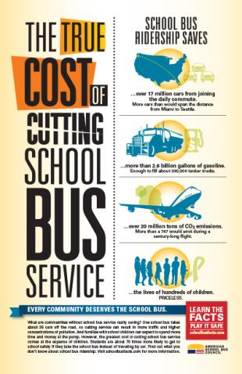
Five Revised Infographics
Notes:
The final two of the original 5 IGs here were updated with relevant data and branding changes as well.
Imagine A Day Without The School Bus illustrates financial, safety, carbon footprint and convenience benefits that the school bus offers by imagining the repercussions that would become reality if the school bus were to disappear for a day. This poster indicates how all community members might be negatively affected without the school bus.
The True Cost Of Cutting School Bus Service also illustrates financial, safety, carbon footprint and convenience benefits that the school bus offers communities. When decision makers consider the cost of school-related transportation, it’s important that they take into consideration exactly what school bus ridership saves. This poster is intended to let all community members know what a cut in school bus service would really cost.

Slide 60
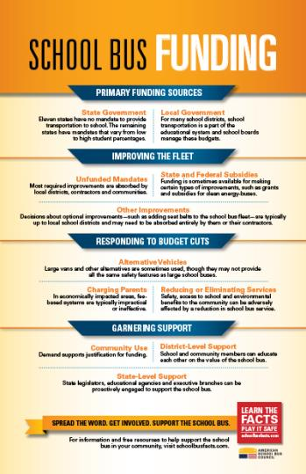
New Infographics
Notes:
Two of the 4 new IG’s can be used as posters.
School Bus Funding identifies the contributing factors that influence the school bus landscape within a community. It includes information about funding sources, making improvements, responding to budget cuts, and garnering support.
School Bus Milestones is a timeline of key reach and development milestones of the school bus. It illustrates the school bus’ positive impact on communities, growth momentum, and safety development features.

Slide 61
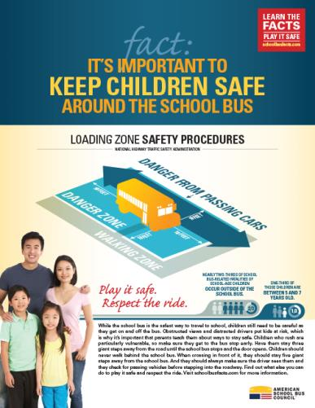
New Inf0graphics
Notes:
Two of the four new IGs created this campaign are to be used as fliers.
Fact: Motorists Who Are Careless Around The School Bus Put Children In Danger is intended to build awareness of the risk factors involved with sharing the road with the school bus, educate motorists about driving safely and reduce social tolerance of unsafe driving behavior.
It’s Important To Keep Children Safe Around The School Bus targets parents, caregivers, and educators and is intended to build awareness of the risk factors in the area surrounding the school bus, educate about safety practices and support caregivers in educating children about ways to stay safe around the school bus.

Slide 62
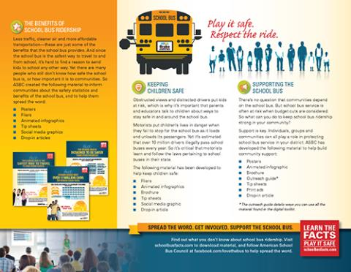
Brochure
Notes:
Spreading The Word About School Bus Ridership: Resources Communities Can Use informs communities on ways to support outreach and marketing efforts for school bus initiatives.
It includes the long list of products we have developed for use by the community and parents.

Slide 63
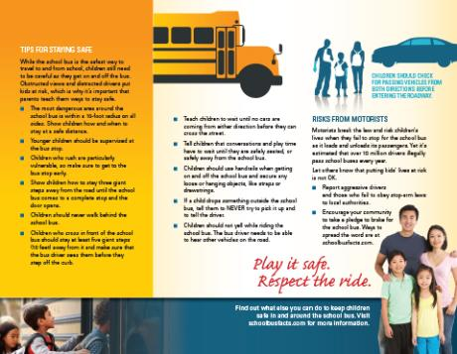
Brochure
Notes:
Steps You Can Take To Make Riding The School Bus Even Safer For Your Child is a tri-fold brochure that targets parents. It is intended to identify risks and provide safety practices that can help keep kids safe while riding the school bus.

Slide 64
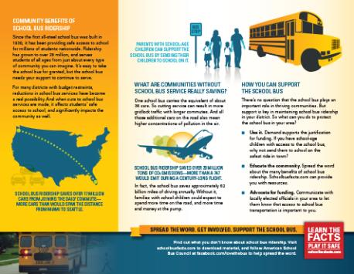
Brochure
Notes:
The Importance Of Supporting School Bus Ridership In Your Community informs parents and educators on ways they can help generate community support for school bus ridership.

Slide 65
National School Transportation Association

Slide 66
NSTA Upcoming Meetings
2017
Annual Meeting & International Safety Competition: Indianapolis, IN, July 15-19
Fall Meeting: Columbus, OH, November 6-7
2018
Midwinter: Maui, Hawaii, January 20-24
Capitol Bus-In: Washington, DC, Spring
Annual Meeting & International Safety Competition: Philadelphia, PA, July 21-25
Fall Meeting: Kansas City, KC

Slide 67
NSTA Involvement
Committees:
Government Relations
Safety & Security
Association & Industry Development
Membership
Awards & Meetings
Marketing & Communications
Manufacturers, Suppliers & Technology
Business Development
Committees meet at NSTA meetings 4 times per year and then via conference call.

Slide 68
NSTA Grants & Awards
Zonar Grant: $50,000 grant for fleet management technology. Open to NSTA members.
NSTA Awards:
Awards given at Annual Meeting in July
Distinguished Service, Outstanding Driver, Outstanding School Administrator, Go Yellow Go Green
Green Fleet Certification
Thomas Built Buses Continuing Education

Slide 69
Contractor Membership Benefits
Insurance
Keystone Insurers Group
Financing
Wells Fargo Equipment Finance
Daimler Financial Line of Credit
Blue Bird Financial Services
Discount Programs
Bus Parts Warehouse
IC Bus Parts/Fleetcharge
Unity Bus Parts
Zonar

Slide 70
NSTA Membership
Annual dues for active fleets up to 750 buses:
$150 for the first bus + $21 for each additional bus
10 buses: $339
50 buses: $1,179
75 buses: $1,704
100 buses: $2,229
250 buses: $5,379
For fleets over 750 buses, equivalent dues levels apply.

Slide 71
Contact Information
Ronna Weber
Executive Director
National School Transportation Association
122 South Royal Street
Alexandria, Virginia 22314
(703) 684-3200
rweber@yellowbuses.org
www.yellowbuses.org

