Slide 1
DOT Medical Exam
Updates and Exam Preparation
Cody D. Heiner, MD, MPH
Certified Medical Examiner for FMCSA
June 29, 2017

Slide 2

Recent DOT Exam Changes

Slide 3

Why The Changes?
“The primary mission of FMCSA is to reduce crashes, injuries, and fatalities involving large trucks and buses.”
CMV drivers are held to higher physical, mental and emotional standards than passenger car drivers.
Old system had its flaws
  Inconsistent exams
  “Doctor shopping”

Slide 4
What Has Changed – NRCME
National Registry of Certified Medical Examiners
Examiners
  Standardized training
  Certification required
  More consistent exams
  Quality control
Drivers
  More difficult to “doctor shop”
  Encourages honest health history disclosure

Slide 5
What Has Changed – Forms
MEC
Medical Examiner’s Certificate
Replaces the old “Long Form”

Slide 6
What Has Changed – Forms
MEC – Medical Examiner’s Certificate
Replaces the old “card”

Slide 7
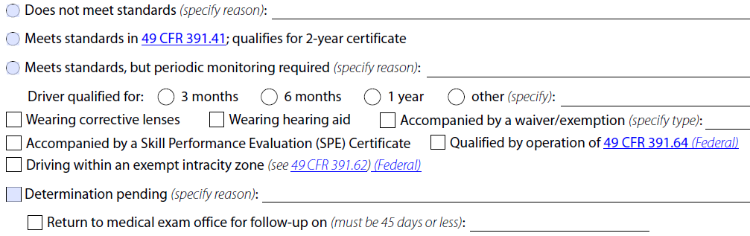
What Has Changed – Certification Options

Slide 8
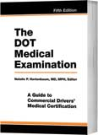
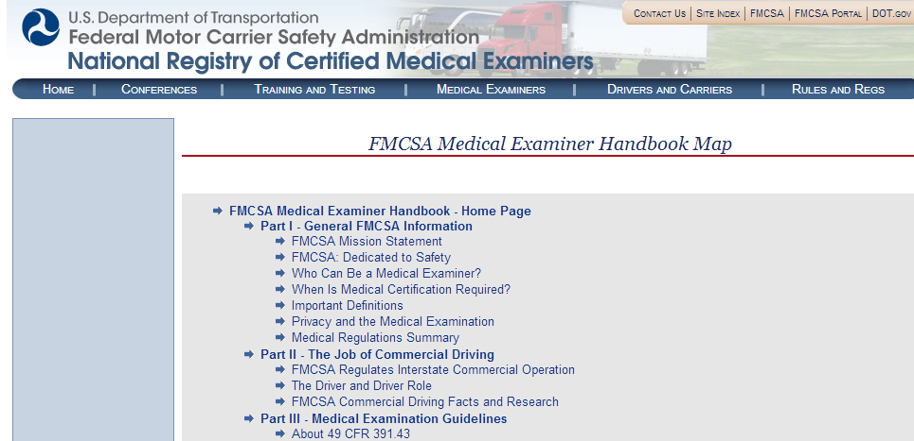
What Has Not Changed
Medical requirements are not new

Slide 9
Standards vs. Guidelines
Standards | Guidelines
Medical Examiner must follow | Not required by law
Found in 49 CFR 391.41 | Based on expert review
Four current standards Vision Hearing Epilepsy Insulin | Considered practice standards Examiner should justify reason for not following the guidelines

Slide 10

Examiner’s Perspective
Commercial Drivers
Public Safety

Slide 11
Driver’s Perspective
Too often we see … | A better approach …
Right | Privilege
Expect | Earn
Just show up | Come prepared
Driver vs. the Doctor | Team (driver, doctor, motor carrier)

Slide 12
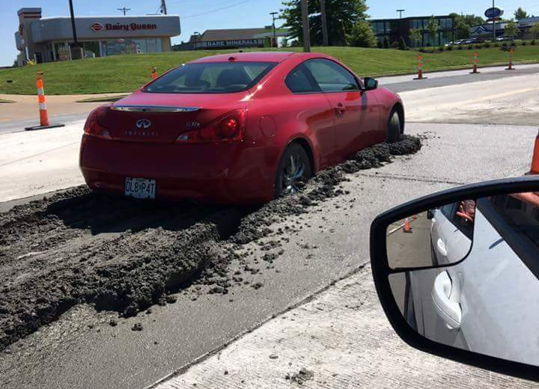
Preparing for your Next DOT Exam

Slide 13
General Recommendations
Schedule in advance
Bring your glasses/contacts and hearing aids
Avoid tobacco, caffeine, and energy drinks, as these may raise your blood pressure
Take your blood pressure medications and any other regular medications as prescribed
Be prepared to provide a urine sample

Slide 14
Prescription Medications
Bring a list of the medications you are currently taking.
Certain medications may necessitate further evaluation
  Letter from your prescribing physician
  Medical record review
Narcotics
Anxiety medications
Blood thinners such as Coumadin

Slide 15
Diabetes
We must document condition is under control
Bring your most recent Hemoglobin A1C lab test result
  Ideally, from within the last 3 months
It is often helpful if you bring a written statement from your doctor documenting good control of your diabetes

Slide 16
Sleep Apnea
Sleep study results
Clearance letter from your sleep specialist
Printout of your CPAP usage over the last 3 months

Slide 17
Anticoagulants
Recent INR
Statement from your physician regarding the reason for and status of your anticoagulation

Slide 18
Cardiac (Heart) Conditions
Most recent stress test
Most recent EKG
Statement from your cardiologist explaining your condition and commenting on your ability to safely fulfill the requirements of a commercial driver

Slide 19
Other Serious Health Conditions
The above is not a complete list of what may be required
When in doubt
  Call ahead with questions regarding your specific condition
  Bring records
  Letter from treating doctor is usually most helpful

Slide 20

Questions?

