Slide 1
Leadership/ communication and commitment
Basic Bus Model

Slide 2
What's NEW,
Following the New format of SDE Basic bus:
Listing all required language included options:
Type A, C and FE

Slide 3
Effective Date: July 1, 2015
Don’t ask what you can do for your document, but what this document can do for you!

Slide 4
Model
Set up like a Menu,
Bid what you want,
Copy the model,
Fill in the blanks,
Don’t forget the yes and no’s.
Follow Idaho code 67-2806.

Slide 5
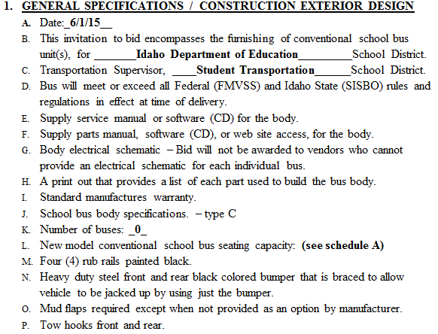
What is looks like:

Slide 6
Let’s take a look at It
Doug Scott,
SDE transportation Director.

